Slide 1
System 1 and System 2
Our preferred theoretical approach is one in which rapid autonomous processes (Type 1) are assumed to yield default responses unless intervened on by distinctive higher order reasoning processes (Type 2).
What defines the difference is that Type 2 processing supports hypothetical thinking and load heavily on working memory.
Minimal definition from Stanovich and West
Cognitively Agnostic

Slide 2
System 1 and 2 in Deep Networks https://doi.org/10.1038/s43588-023-00527-x
On the surface, current-day LLMs seem to be system 1 thinkers: the input text is processed by consecutive layers of neurons to produce a distribution of probabilities of all possible single-token (word) comple- tions. This process is automatic and unidirectional, and involves a single wave of propagation through the neural network for each consecutive predicted word
BUT LLMs re-read their context window, including the task provided by a user, as well as the words they have thus far generated. As a result, LLMs can employ their context window as a form of an external short-term memory
To engage in chain-of-thought reasoning, re-examine the starting assumptions, estimate partial solutions or test alternative approaches. This is akin to how people use notepads to solve mathematical problems or write essays to sharpen and develop their arguments.

Slide 3
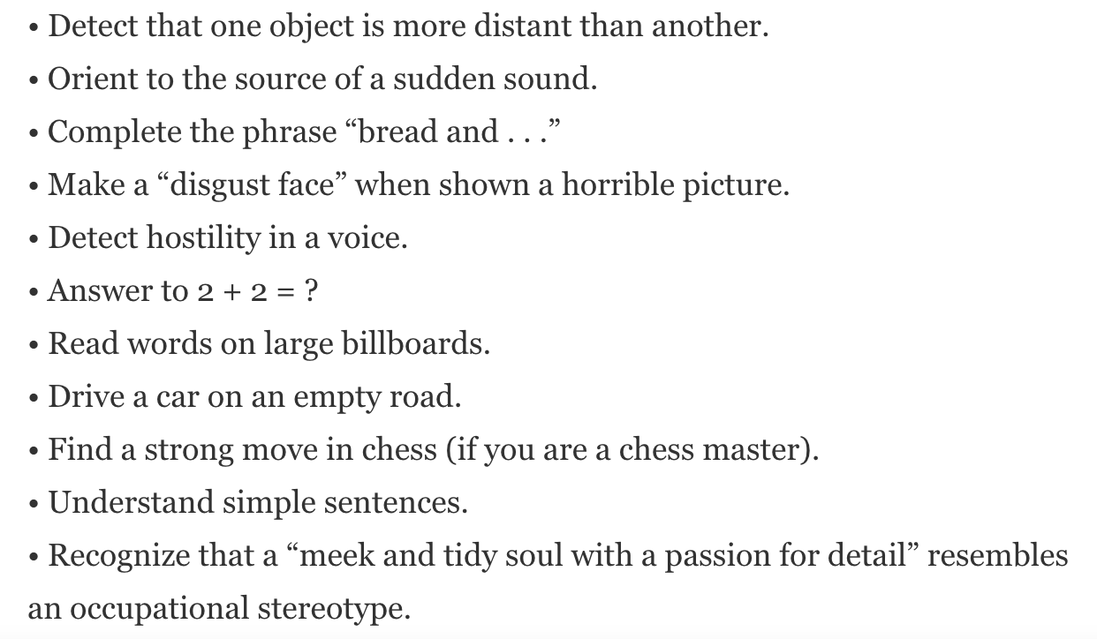
system 1

Slide 4
System 2 Attentionally demanding

Slide 5
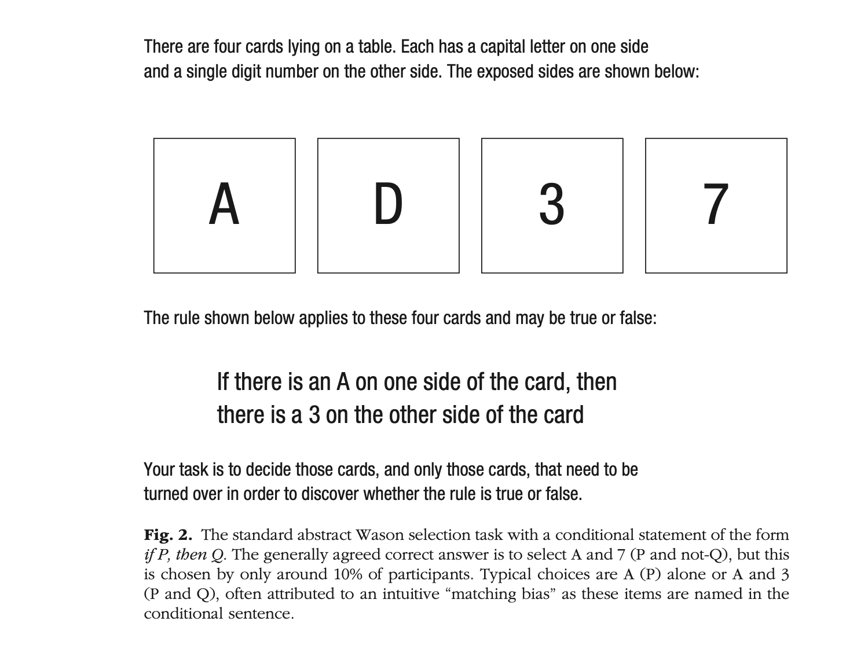

Slide 6
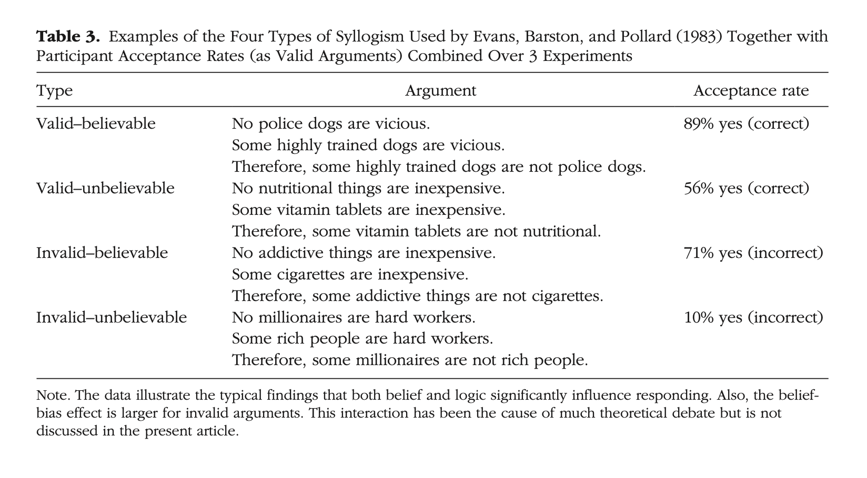

Slide 7
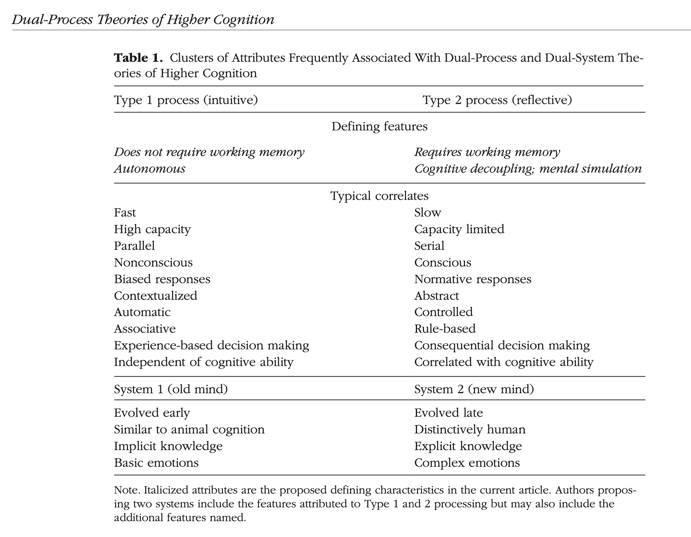

Slide 8
Active Maintenance in the Brain
Many theoretical perspectives summarize the function of frontal cortex in terms of ‘executive control’,‘controlled processing’, or a ‘central executive’ (e.g.Baddeley, 1986; Shallice, 1982; Gathercole, 1994;Shiffrin and Schneider, 1977), without explaining at a mechanistic level how such functionality couldbe achieved. Computational models provide an important tool for exploring specific mechanisms that might achieve ‘executive-like’ functionality
“the fundamental mechanism underlying frontal function is ‘active maintenance’,which then enables all the other ‘executive’ functionality ascribed to the frontal cortex” https://onlinelibrary.wiley.com/doi/epdf/10.1002/0470018860.s00051
In other words, stimulus independent decoupled activity maintained by prefrontal activity that constructs transient large scale distributed patterns that across prefrontal and posterior structures

Slide 9
Architecture?
Dual process theories don’t implicate any particular computational architecture.
But many, especially Evolutionary Psychologists take the patterns of performance to support the inference to a modular architecture of subsystems specialized for particular cognitive processes with domain specific representation and algorithm
Goes naturally with the classical architecture of modular and central processes.
Modular system 1. Central System 2.

Slide 10
Unidirectional Neural Networks
Neural Networks are Unspecialised
LLMS like GPT do not distinguish domain knowledge.
They are a single “central system” that does stochastic analysis.
But unidirectional networks have none of the properties of human central systems
Which have executive functions that do perform (i) active maintenance (ii) decoupling
in other words humans do not need a stimulus to be able to process information relevant to a task
We can maintain attention on information not present in the environment
That is the essence of so-called System 2.

Slide 11
Biderectional Neural Networks.
Output from some nodes affects subsequent input to those nodes
LTSM
Mimics aspects of human Executive Function
Activation in early layers can influence processing in later layers even if not driven from below
Makes processing recurrent
LTSM massive improvement in text and language processing

Slide 12
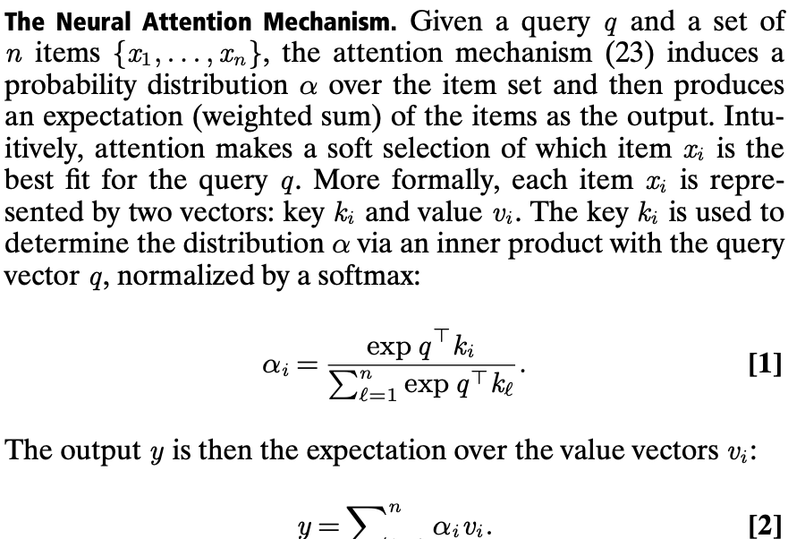
GPT Attentional Transformer
Key feature is the ability to “attend” to salient information

Slide 13
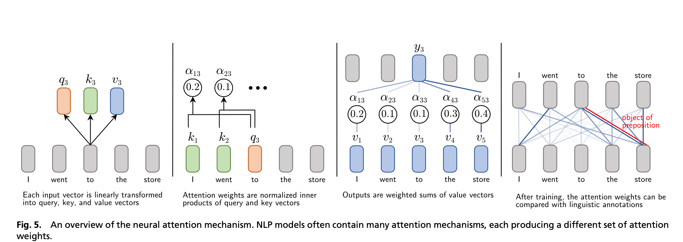
GPT Attentional Transformer
Key feature is the ability to “attend” to salient information

Slide 14
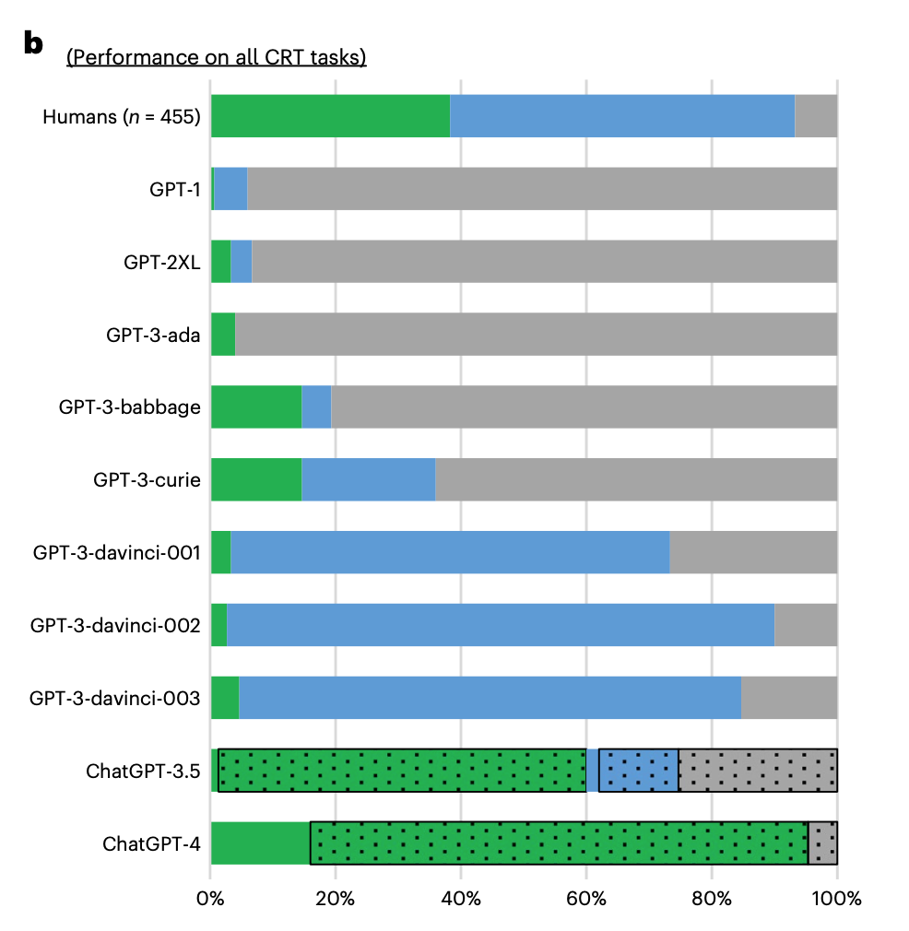
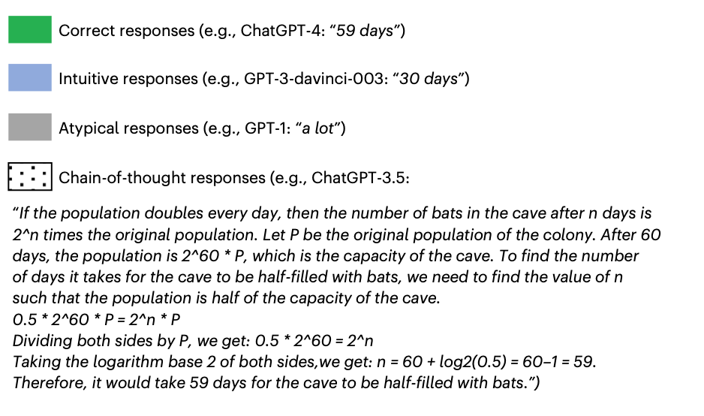
CRT Type 3 task 14: In a cave, there is a colony of bats with a daily population doubling. Given that it takes 60 days for the entire cave to be filled with bats, how many days would it take for the cave to be half-filled with bats?

Slide 15
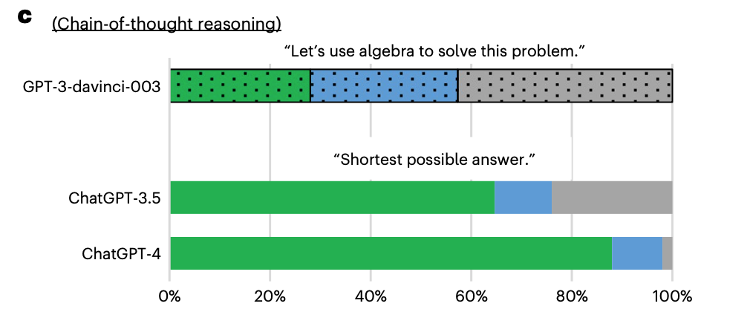
CHAIN OF THOUGHT REASONING

Slide 16
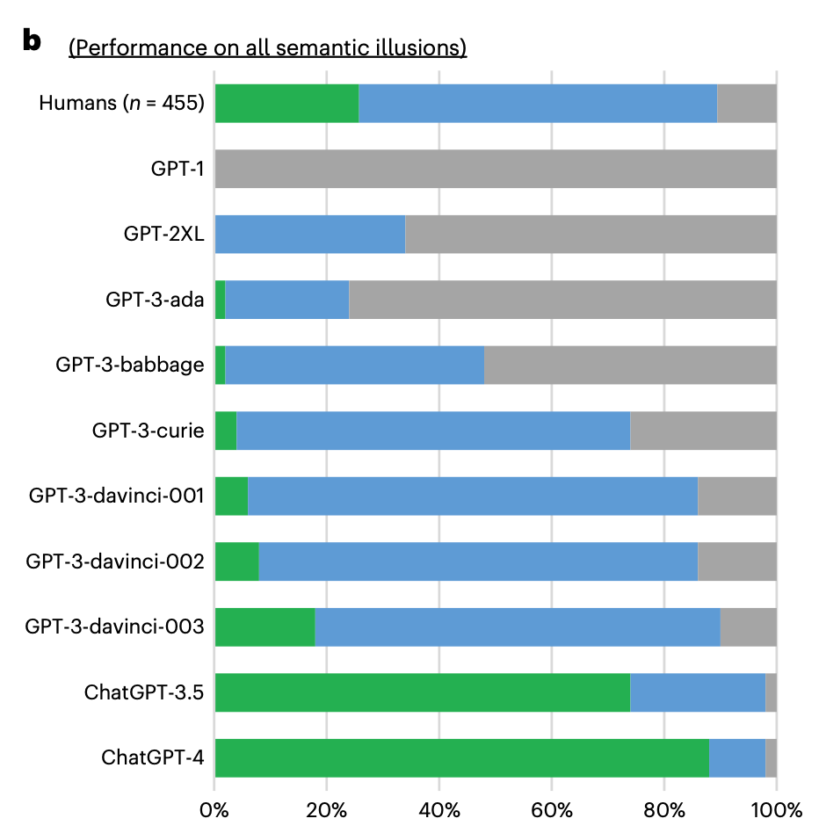
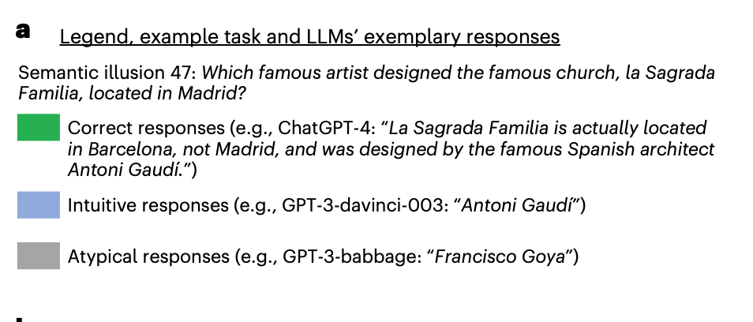
SEMANTIC TRAPS

Slide 17
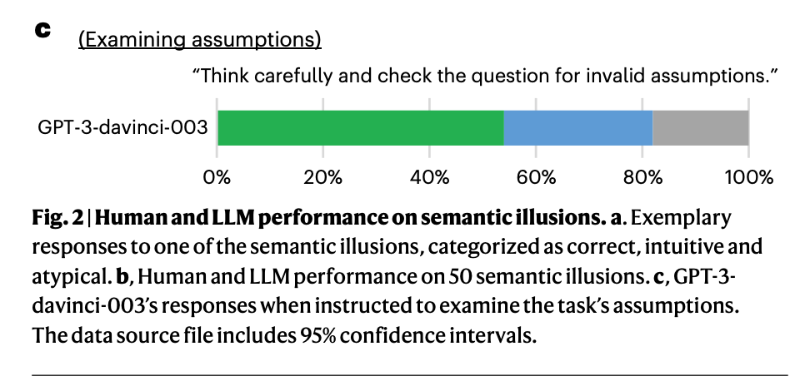
SEMANTIC TRAPS continued
LLMs’ propensity to commit reasoning errors in the CRT tasks can be reduced by instructing them to examine the task more carefully and providing them with examples of correct solutions to similar tasks.
Study 5 replicates these results in the context of semantic illusions.

Slide 18
Author’s conclusions
As LLMs’ ability to comprehend the tasks increases, they tend to fall for the traps embedded in the tasks. This, in humans, would be interpreted as evidence of fast, automatic and instinctual system 1 processing
LLMs lack the cognitive infrastructure necessary to engage in system 2 processes, which humans may employ when answering such questions. Thus, in the absence of well developed intuition or explicit chain-of-thought reasoning, they are particularly prone to fall for the traps embedded in the tasks.
how would we explain the steep shift in accuracy between GPT-3 and ChatGPT? ChatGPT models tend to engage in chain-of-thought reasoning: the models use their input–output con- text window to develop strategies needed to solve the task, examine the starting assumptions, estimate partial solutions or test alterna- tive approaches—in a way akin to how people use notepads to solve mathematical problems or write essays to develop their arguments. Instructing an older model (that is, GPT-3-davinci-003) to engage in chain-of-thought reasoning substantially boosts its performance.
Yet, chain-of-thought reasoning cannot be the sole explanation. ChatGPT models’ accuracy barely drops when they are prevented from engaging in chain-of-thought reasoning. This suggests that they have well developed intuitions enabling them to solve tasks without engag- ing system-2-like processes. This is confirmed by results showing that GPT-3-davinci-003’s performance can be substantially increased by presenting it with example tasks and their correct solutions.

Slide 19
Significance for this course
Opacity of LLMs is a large problem (allegedly)
Authors are suggesting that the approach to the question should not be different than approach to the human mind.
Inference to emergent cognitive architecture from psychological probes

Slide 20
Back to Psychology
The progress in LLMs not only increased their capabilities, but also reduced our ability to anticipate their properties and behavior. It is increasingly difficult to study LLMs through the lenses of their architecture and hyperparameters. Instead, as we show in this work, LLMs can be studied using methods designed to investigate another capable and opaque structure, namely the human mind. Our approach falls within a quickly growing category of studies employing classic psychological tests and experiments to probe LLM ‘psychological’ processes, such as judgment, decision-making and cognitive biases
Caveat “Intuitive” “ecological” is always tested by departure from some ideal norm of rationality. E.g. logic, Bayesian reasoning. But it is not clear that that is how humans think in real world contexts…unfortunately

